Slide 1
WELCOME

Slide 2
INTRODUCTION TO DBMS & MYSQL DDL, DML, DCL

Slide 3

What is Database?
A collection of information organized in such a way that a computer program can quickly select desired pieces of data.
You can think of a database as an electronic filing system.

Slide 4
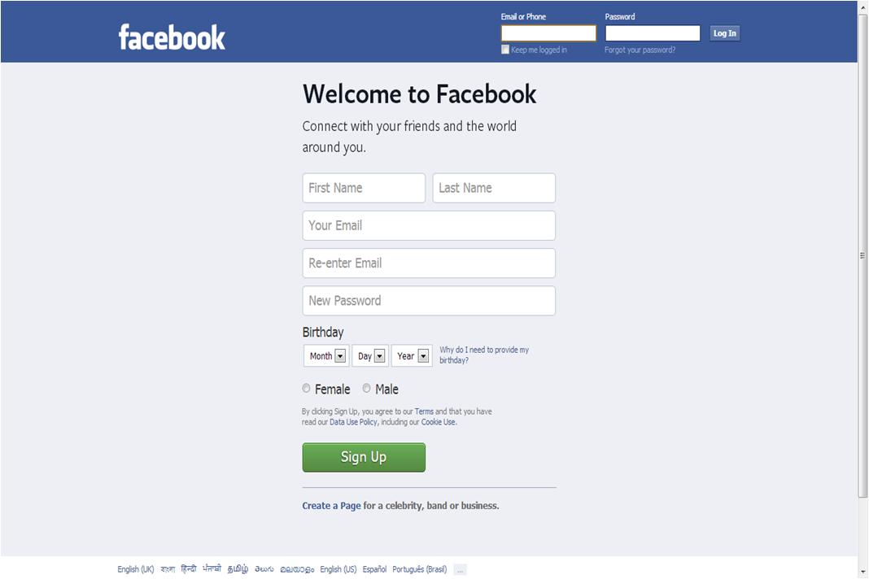

Where do we use Database?
Stores data at the Back end database in MYSQL/SQL Server / Oracle or any other DBMS
Front End: done in PHP / .Net / JSP or any server side scripting languages

Slide 5
Database management system (DBMS)
DBMS is a computer software providing the interface between users and a database (or databases)
It is a software system designed to allow the definition, creation, querying, update, and administration of databases
Different types of DBMS are RDBMS, Object Oriented DBMS, Network DBMS, Hierarchical DBMS
Examples :Oracle, Mysql, PostgreSQl, SQL server, Firebird etc

Slide 6
“ The RDBMS follows
Entity- Relationship model”

Slide 7
What is Entity – Relationship (ER) Data Model ?
In ER model all the data will be viewed as Entities, Attributes and different relations that can be defined between entities
Entities
Is an object in the real world that is distinguishable from other objects
Ex. Employees, Places
Attributes
An entity is described in the database using a set of attributes
Ex. Employee_Name, Employee_Age, Gender
Relationships
A relationship is an association among two or more entities

Slide 8
Entity – Relationship (ER) Data Model ?
So a relation means simply a two dimensional table
Entities will be data with in a table
And attributes will be the columns of that table

Slide 9
Relational model basics
Data is viewed as existing in two dimensional tables known as relations.
A relation (table) consists of unique attributes (columns) and tuples (rows)
RDBMS: A DBMS that manages the relational database.
Ex: MySQL , Oracle, DB2
Attributes/Fields/Columns
Pk_int_Emp_id | Vchr_Emp_name | Emp_age | Emp_email
1000 | Deepak | 24 | dk@gmail.com
1001 | Aneesh | 23 | an@gmail.com
1002 | Naveen | 25 | nn@gmail.com
1003 | Jacob | 25 | jb@gmail.com
Rows/ Records/ Tuples

Slide 10
Relational model Example
Tbl_designation
Tbl_place
Pk_int_id | Vchr_Designation
1 | Area manager
2 | Supervisor
3 | Software Engineer
4 | Clerk
Pk_int_id | Vchr_place
1 | Mumbai
2 | Kolkata
3 | Bangalore
4 | Cochin
Tbl_employee
Pk_int_Emp_id | Vchr_Emp_name | Int_Emp_age | Vchr_Emp_email | Fk_int_designation | fk_int_place_id
1000 | Deepak | 24 | dk@gmail.com | 1 | 1
1001 | Aneesh | 23 | an@gmail.com | 2 | 1
1002 | Naveen | 25 | nn@gmail.com | 1 | 2
1003 | Jacob | 25 | jb@gmail.com | 3 | 4

Slide 11
Keys in relational Model
Primary Key
Here there are 2 employees with name “Deepak” but each can be identified distinctly by defining a primary key
Vchr_Emp_name | Int_Emp_age | Vchr_Emp_email | Fk_int_designation | Pk_int_place_id
Deepak | 45 | dk@gmail.com | 1 | 1
Aneesh | 23 | an@gmail.com | 2 | 1
Naveen | 25 | nn@gmail.com | 1 | 2
Deepak | 25 | dpk@gmail.com | 4 | 4

Slide 12
MySQL
It is the world's most used open source relational database management system (RDBMS).It is named after cofounder Michael Widenius' daughter, My. The SQL phrase stands for Structured Query Language
In January 2008, Sun Microsystems bought MySQL for $1 billion

Slide 13
3 Types Of SQL Statements
Data Definition Language (DDL)
Data Manipulation Language (DML)
Data Control Language (DCL) statements.

Slide 14
DDL Statements

Slide 15
Definition Language (DDL)
They are used to define the database structure or schema.
-Create
-Alter
-Drop
-Truncate

Slide 16
Create - Database
To create a Database
Syntax : CREATE DATABASE dbname;
Example : CREATE DATABASE my_db;
To Use a database
Syntax : Use dbname;
Example : Use my_db;

Slide 17
Creating a table
Syntax
CREATE TABLE table_name ( column_name1 data_type(size), column_name2 data_type(size), column_name3 data_type(size), PRIMARY KEY(column_name1) );
Example
CREATE TABLE Persons ( PersonID int auto_increment, FirstName varchar(255), Address varchar(255), City varchar(255),
Primary key(PersonalID)
);

Slide 18
DDL - Altering a table
ALTER TABLE Persons ADD email VARCHAR(60);
ALTER TABLE Persons DROP COLUMN city;
ALTER TABLE Persons CHANGE FirstName FullName VARCHAR(20);
DDL - Deleting a Table
DROP TABLE table_name ;

Slide 19
DML Statements

Slide 20
Data Manipulation Language (DML)
They are used for managing data within schema objects.
-Insert
-Update
-Delete
-Select

Slide 21
DML - Insert Data into a table
Syntax :
INSERT INTO table_name VALUES (value1,value2,value3,...);
Example:
INSERT INTO Customers (CustomerName, City, Country) VALUES (baabtra', ‘Calicut', ‘India');
Note : String and date values are specified as quoted string. Also with insert you can insert NULL directly to represent a missing value.

Slide 22
DML -Retrieving information from a table
“The SELECT statement is used to pull data from a table”
Syntax:
SELECT what_to_select FROM table_name Where conditions_to_satisfy ;
What_to_select indicates what you want to see. This can be a list of columns or * to indicate “all columns”.
The Where clause is optional. If it is present, conditions_to_satisfy specifies one or more conditions that rows must satisfy to qualify for retrieval.

Slide 23
DML - Example
Select * from person;
Select id,firstname from person;
Select * from person where city=‘banglore’

Slide 24
DML - Update Query
Syntax:
UPDATE table_name SET column1=value1,column2=value2,... WHERE some_column=some_value;
Example:
UPDATE Customers SET ContactName=‘Alex', City=‘calicut' WHERE CustomerName=‘baabtra';

Slide 25
Delete Query
Syntax:
DELETE FROM table_name WHERE some_column=some_value;
Example:
DELETE FROM Customers WHERE CustomerName=‘baabtra' AND ContactName='Maria';

Slide 26
DCL Statements

Slide 27
Data Control Language (DCL)
Used to create roles, permissions, and referential integrity as well it is used to control access to database by securing it.
-Grant
-Revoke
-Commit
-Rollback

Slide 28
DCL – Setting Privilege
Example:
GRANT ALL ON baabtra.user TO 'someuser'@'somehost';
REVOKE ALL ON baabtra.user FROM 'jeffrey'@'localhost';
What previlages to be given
All -> will set all the privileges
SELECT-> will set only to select privilage
table name
Username

Slide 29

Woooh….!!! That really works…
So we are done with our TASK of the day.
That was great…!!!

Slide 30
INTRODUCTION TO MYSQL- GROUPING, SCALAR AND AGGREGATE FUNCTIONS, JOINS

Slide 31
SQL Functions
SQL has many built-in functions for performing calculations on data. It can be broadly classified in to two
Aggregate Functions
Scalar functions

Slide 32
SQL Functions
Aggregate Functions
SQL aggregate functions return a single value, calculated from all the values in a column.
Select AVG(int_price) from tbl_stock; // returns 8
Select SUM(int_price) from tbl_stock; // returns 33
Select MIN(int_price) from tbl_stock; // returns 2
Select COUNT(vchr_product) from tbl_stock; // returns 4
Tbl_stock
Pk_int_id | Vchr_product | Int_price
1 | Pen | 10
2 | Book | 15
3 | Eraser | 2
4 | Pencil | 6
Returns a single value

Slide 33
SQL Functions
Scalar Functions
SQL scalar functions return a single value for each values of a particular column given as input.
Select UCASE(vchr_product) from tbl_stock; // returns each column value in capital letter
Select LCASE(vchr_product) from tbl_stock; // returns each column value in small letter
Select ROUND(int_price) from tbl_stock; // returns each column value in a rounded figure
Tbl_product
Pk_int_id | Vchr_product | Int_price
1 | Pen | 10
2 | Book | 15
3 | Eraser | 2
4 | Pencil | 6
Returns a value
Returns a value
Returns a value
Returns a value

Slide 34
Grouping Data
GROUP BY allows you to take your result set, group it into logical groups and then run aggregate queries on the groups.
You could for instance select all employees, group them by their workplace location and calculate the average salary. This would give you the average salary of an employee at a given location in your database.
Tbl_employee
Emp_id | Emp_name | Emp_age | Emp_email | int_salary | vchr_place
1000 | Deepak | 24 | dk@gmail.com | 10000 | Cochin
1001 | Aneesh | 23 | an@gmail.com | 20000 | Calicut
1002 | Naveen | 25 | nn@gmail.com | 15000 | Cochin
1003 | Jacob | 25 | jb@gmail.com | 13000 | Calicut
Avg = 12500
Avg = 11500

Slide 35
Select vchr_place, avg(int_salary) from tbl_employee group by vchr_place;
Example
Tbl_employee
Emp_id | Emp_name | Emp_age | Emp_email | int_salary | vchr_place
1000 | Deepak | 24 | dk@gmail.com | 10000 | Cochin
1001 | Aneesh | 23 | an@gmail.com | 20000 | Calicut
1002 | Naveen | 25 | nn@gmail.com | 15000 | Cochin
1003 | Jacob | 25 | jb@gmail.com | 13000 | Calicut
Result :
Vchr_place | Avg(int_alary)
Cochin | 12500
Calicut | 11500

Slide 36
The HAVING Clause
The HAVING clause was added to SQL because the WHERE keyword could not be used with aggregate functions.
An Sql statement can have both ‘where’ clause and ‘having’ clause. Where filteres data before grouping.Having filters data after grouping
Syntax:
SELECT column_name, aggregate_function(column_name) FROM table_name WHERE column_name operator value GROUP BY column_name HAVING aggregate_function(column_name) operator value;

Slide 37
Example
vchr_place | avg(int_alary)
Cochin | 12500
Calicut | 11500
Select vchr_place, avg(int_salary) from tbl_employee group by vchr_place having avg(int_salary)>12000;
vchr_place | Avg(int_salary)
Cochin | 12500

Slide 38
JOINS

Slide 39
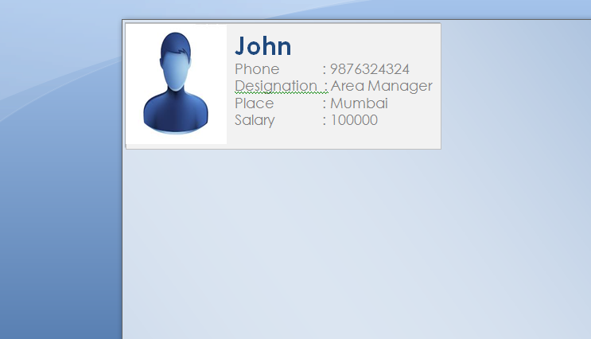
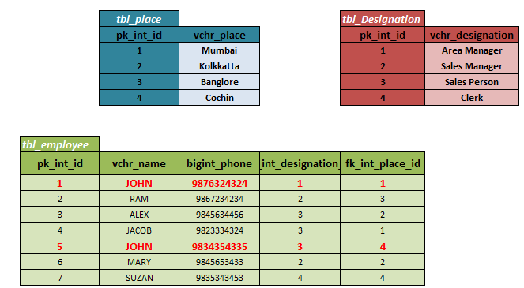
Where do we use joins?
An SQL JOIN clause is used to combine rows from two or more tables, based on a common field between them.
Join helps to write single query to fetch data from multiple tables so as to meet the business requirement/generate reports

Slide 40
Types Of joins
Inner join
Outer Join
Left Outer Join
Right Outer Join

Slide 41
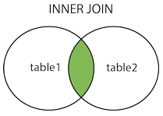
Inner Join
The INNER JOIN keyword selects all rows from both tables as long as there is a match between the columns in both tables.
Syntax
SELECT column_name(s) FROM table1 INNER JOIN table2 ON table1.column_name=table2.column_name;

Slide 42
Inner Join
SELECT emp_id,emp_name, vchr_place from tbl_employee Join tbl_place on fk_int_place_id=pk_int_id
Emp_id | Emp_name | fk_int_place_id
1000 | Deepak | 1
1001 | Aneesh | 3
1002 | Naveen | 2
1003 | Jacob | 5
Pk_int_id | Vchr_place
1 | Mumbai
2 | Kolkata
3 | Bangalore
4 | Cochin
Inner Join
Emp_id | Emp_name | Vchr_place
1000 | Deepak | Mumbai
1001 | Aneesh | Banglore
1002 | Naveen | Kolkatta

Slide 43
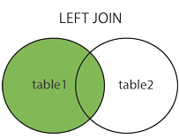
Left Outer Join
The LEFT JOIN keyword returns all rows from the left table (table1), with the matching rows in the right table (table2). The result is NULL in the right side when there is no match.
SELECT column_name(s) FROM table1 LEFT JOIN table2 ON table1.column_name=table2.column_name;

Slide 44
Left Outer Join
SELECT emp_id,emp_name, vchr_place from tbl_employee Left Join tbl_place on fk_int_place_id=pk_int_id
Emp_id | Emp_name | fk_int_place_id
1000 | Deepak | 1
1001 | Aneesh | 4
1002 | Naveen | 2
1003 | Jacob | 5
1004 | Alex | 6
Pk_int_id | Vchr_place
1 | Mumbai
2 | Kolkata
3 | Bangalore
4 | Cochin
Left Join
Emp_id | Emp_name | Vchr_place
1000 | Deepak | Mumbai
1001 | Aneesh | Cochin
1002 | Naveen | Kolkatta
1003 | Jacob | NULL
1004 | Alex | NULL

Slide 45
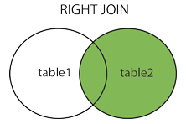
Right Outer Join
The RIGHT JOIN keyword returns all rows from the right table (table2), with the matching rows in the left table (table1). The result is NULL in the left side when there is no match.
SELECT column_name(s) FROM table1 RIGHT JOIN table2 ON table1.column_name=table2.column_name;

Slide 46
Right Outer Join
SELECT emp_id,emp_name, vchr_place from tbl_employee Right Join tbl_place on fk_int_place_id=pk_int_id
Emp_id | Emp_name | fk_int_place_id
1000 | Deepak | 1
1001 | Aneesh | 4
1002 | Naveen | 2
1003 | Jacob | 5
1004 | Alex | 6
Pk_int_id | Vchr_place
1 | Mumbai
2 | Kolkata
3 | Bangalore
4 | Cochin
5 | Trivandrum
7 | Delhi
Right Join
Emp_id | Emp_name | Vchr_place
1000 | Deepak | Mumbai
1001 | Aneesh | Cochin
1002 | Naveen | Kolkatta
1003 | Jacob | Trivandrum
NULL | NULL | Banglore
NULL | NULL | Delhi

Slide 47
Woooh….!!! That really works…
So we are done with our TASK of the day.
That was great…!!!

Slide 48

END OF THE SESSION

